Slide 1


Planes, Trains, Apples, and Oranges Reproducible Results and Fair Comparisons in Localization Research
Pat Pannuto
UC Berkeley
CPS-IoTBench’19
April 15, 2019

Slide 2
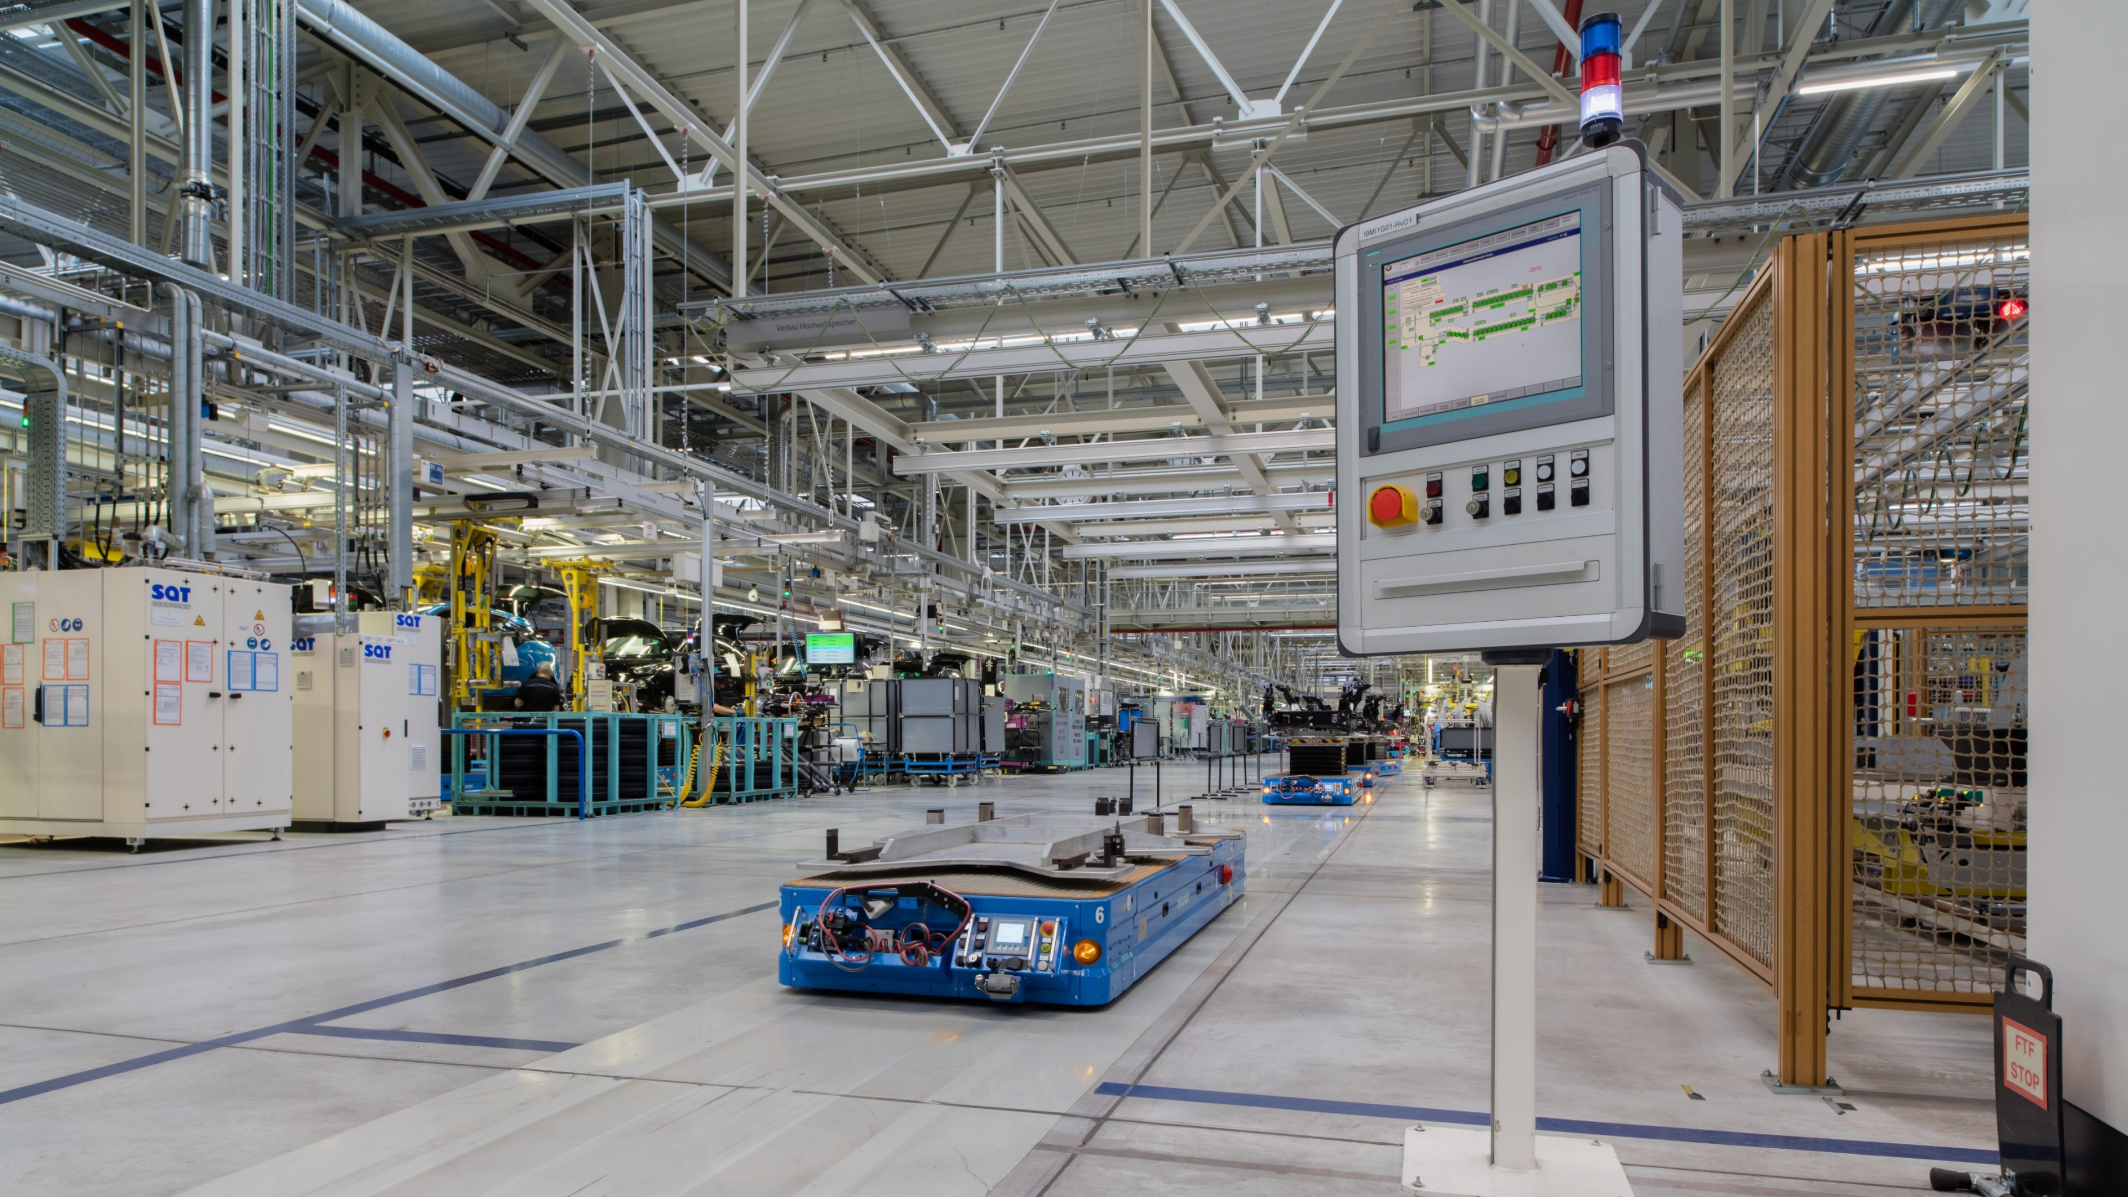
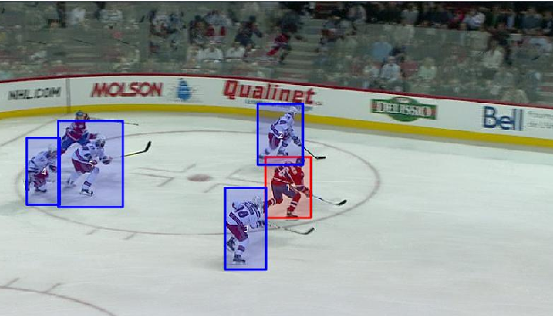
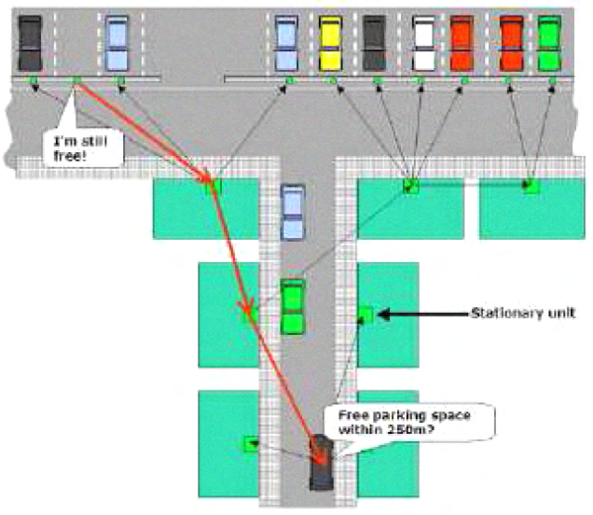
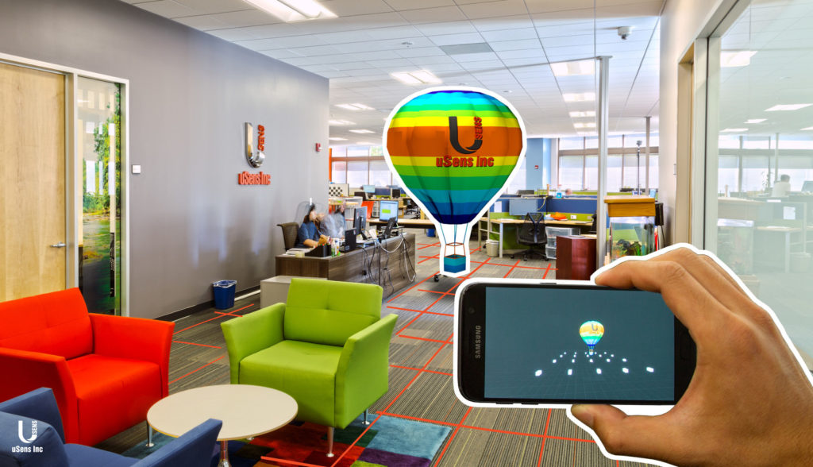
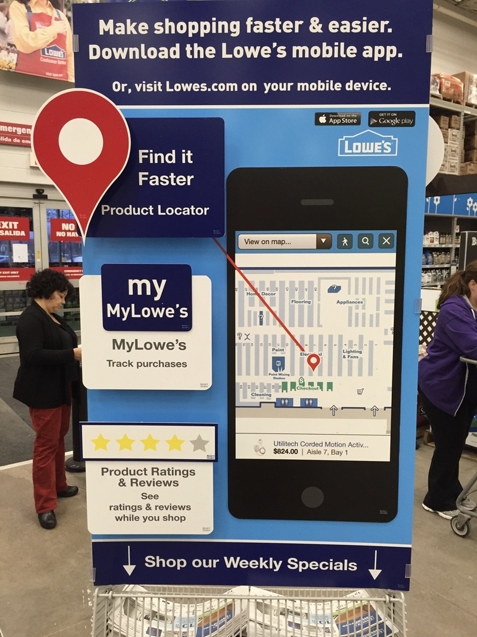
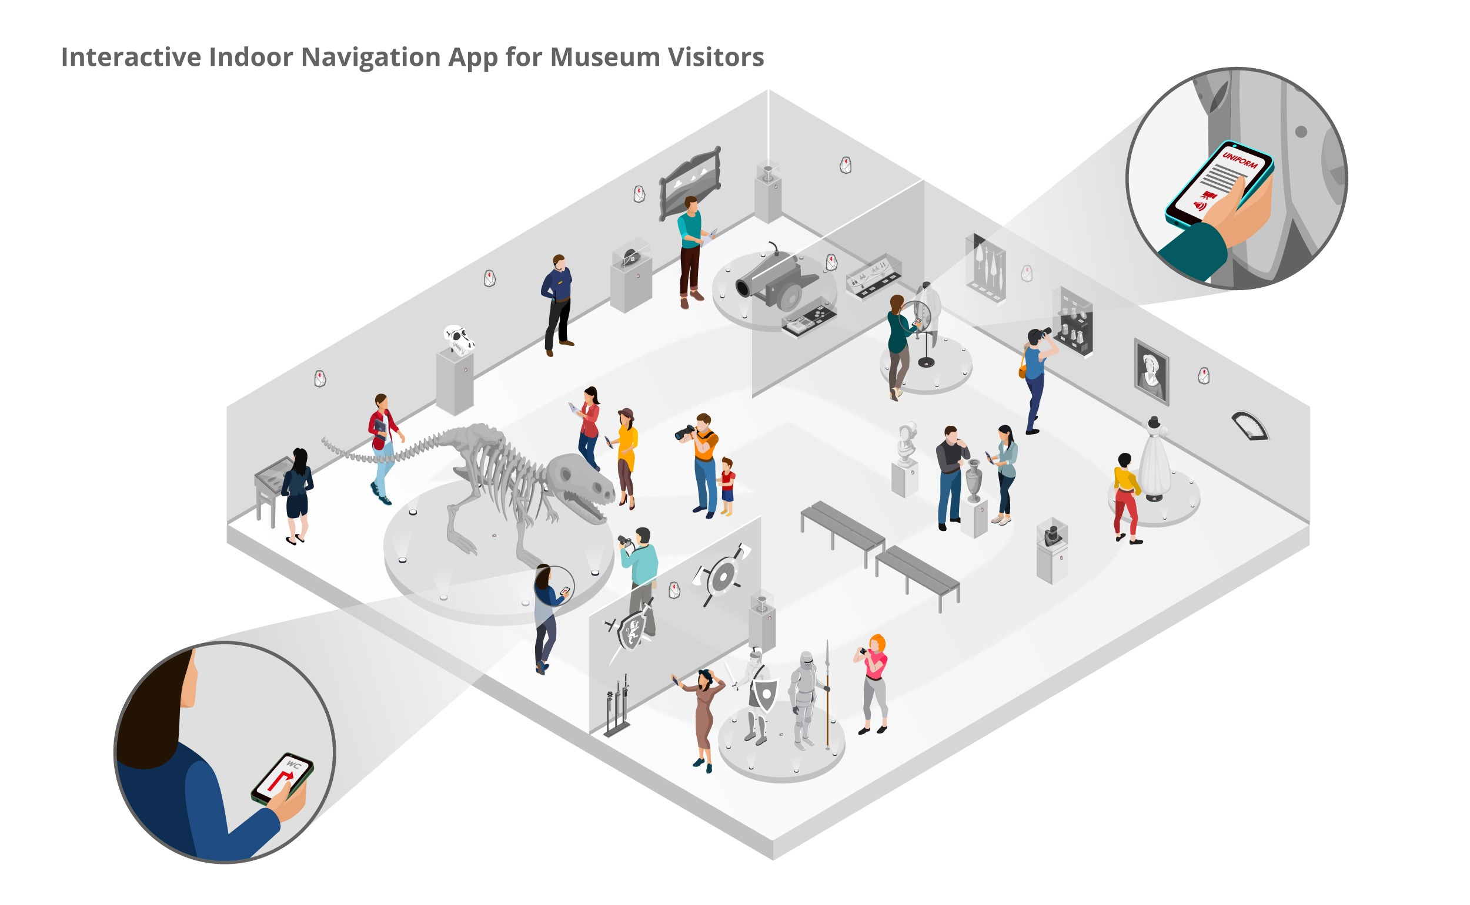
Localization empowers current and future technologies
Infrastructure
Monitoring
Autonomous Factories, Warehouses
Sports & Analytics
Augmented Reality
Guided Tours

Slide 3
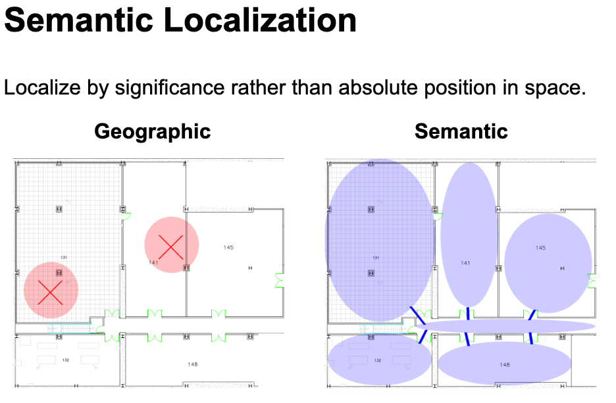
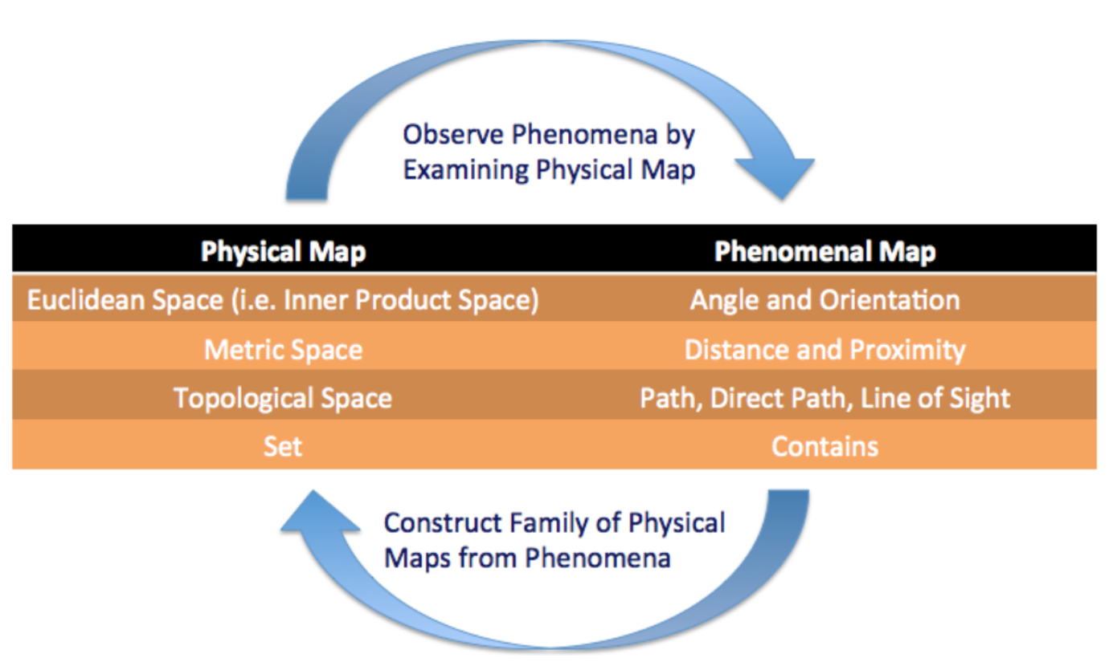
But localization means many things to many people
Matthew Weber, Self-Organizing Semantic Localization, TerraSwarm (2013)
Matthew Weber, Edward Lee, A Model for Semantic Localization, IPSN (2015)

Slide 4
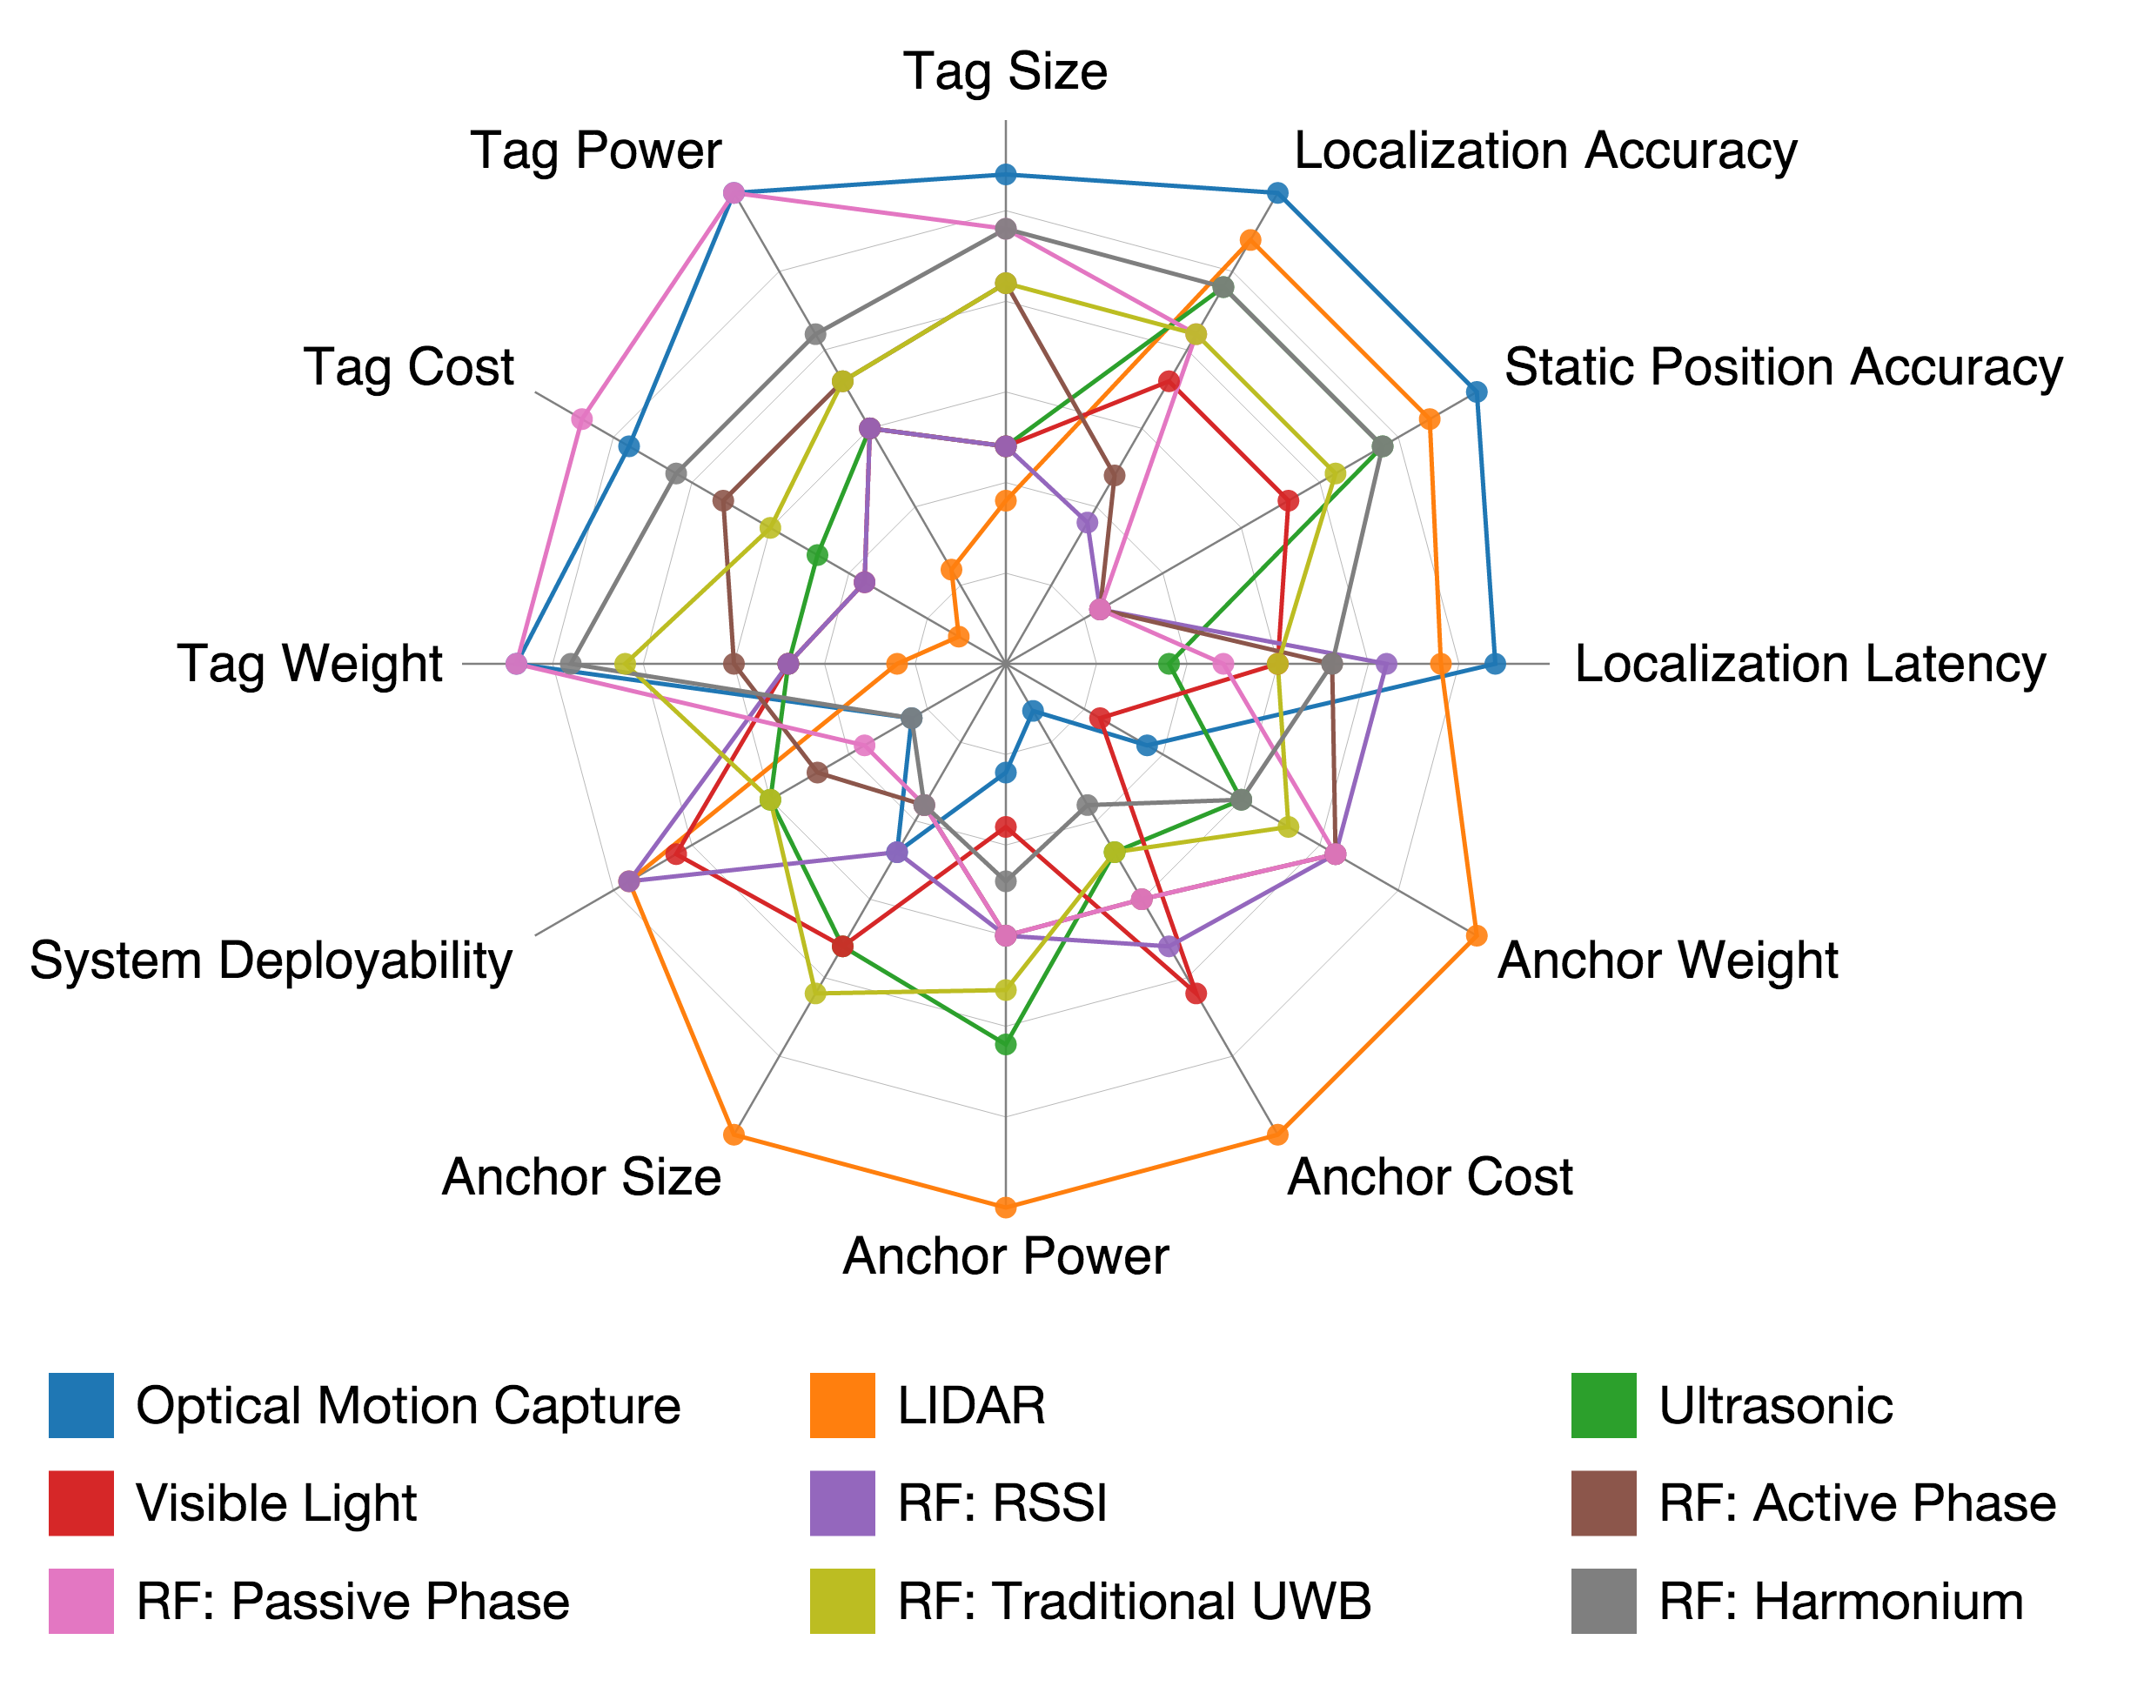
Which leads to a wide array of considerations for localization systems
Here are 12 dimensions
Covering 9 technologies
Each have several implementations
(bigger is better) →
No one technology will suit all applications
What does it mean to localize a person to 1cm?
Motion? Through-wall?

Slide 5
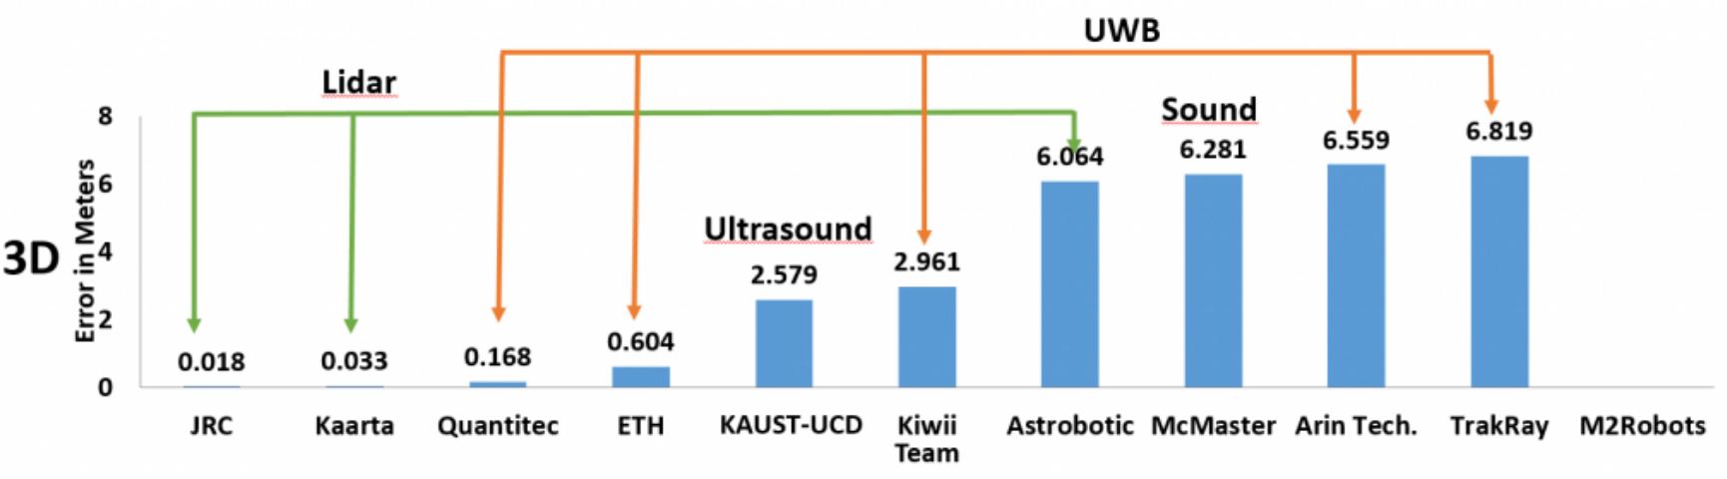
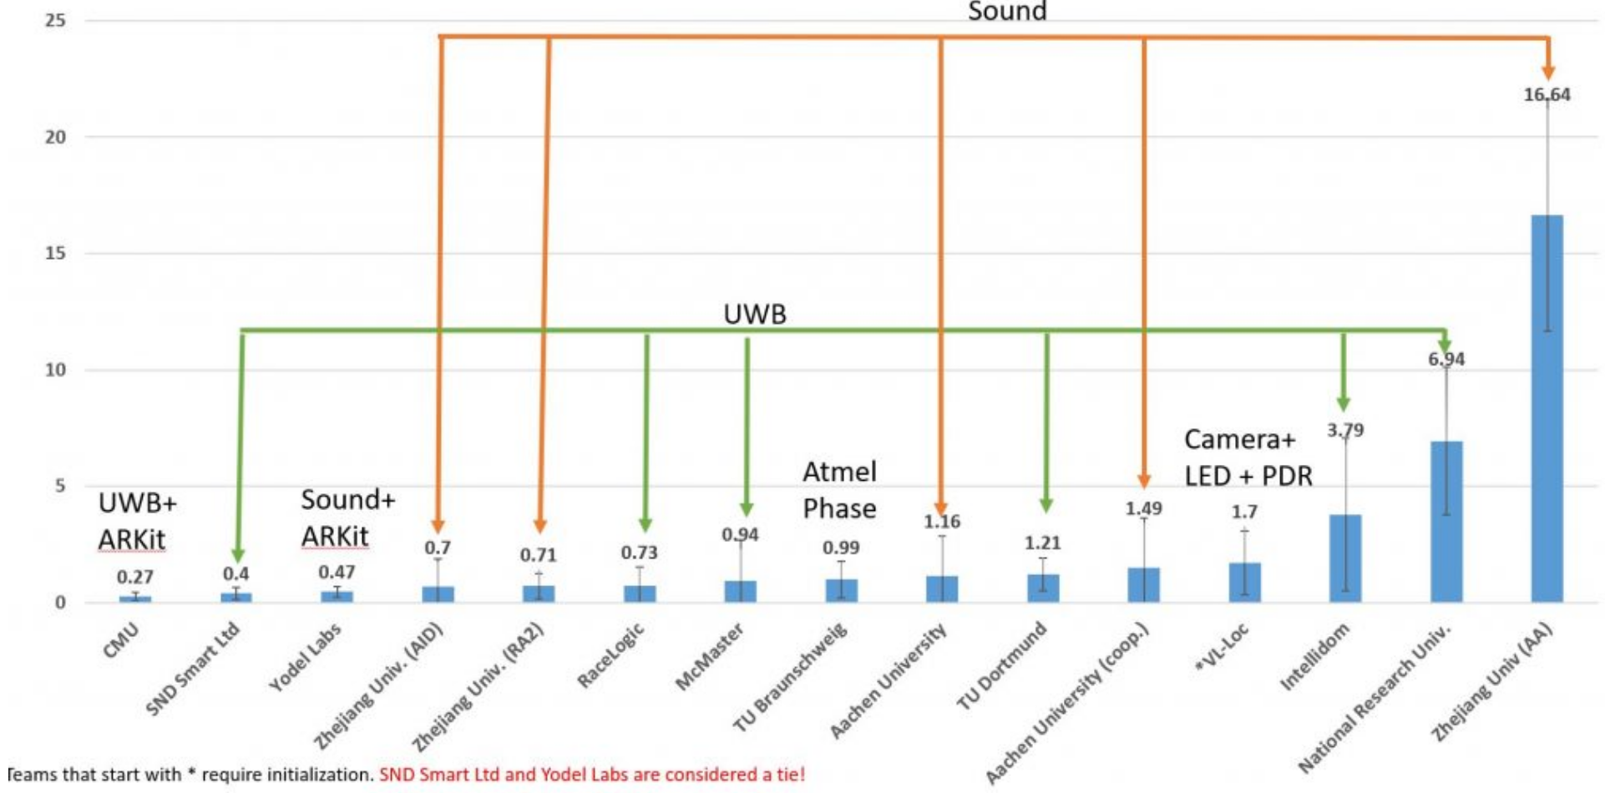
What happens with a shared benchmark? Case Study: The Microsoft Indoor Localization Competition
“solved” accuracy, and a little bit deployability
2015
2017
3D positioning — in uncontrolled, real-world environments — from meters to centimeters over a few years
2018
2016

Slide 6
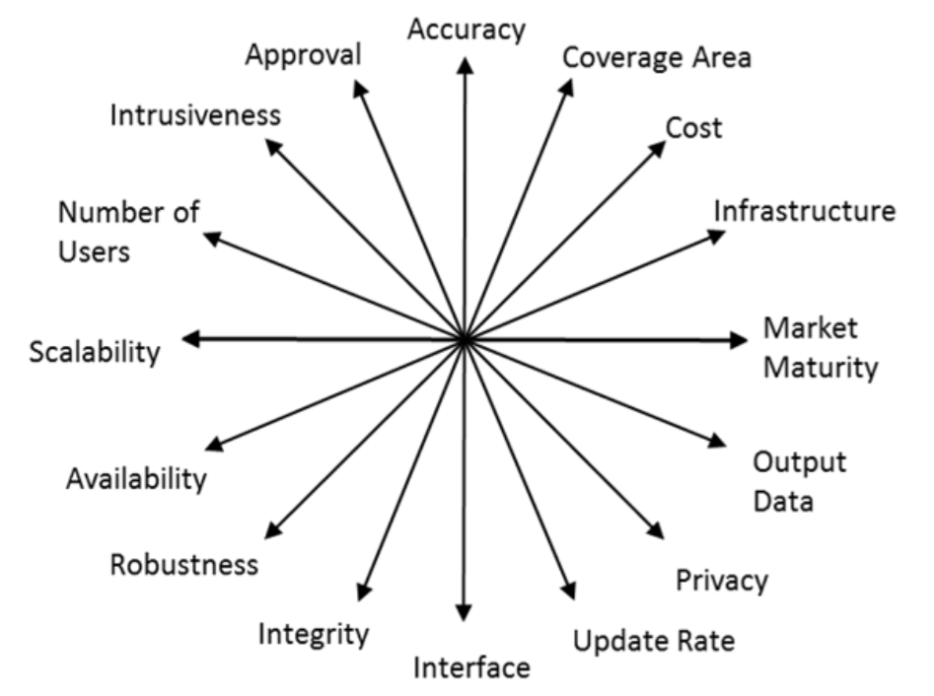
Competitions for every possible combination do not scale
Results in fragmentation
How do you “fairly” compare systems with different application requirements?
Mautz, Rainer. "Indoor positioning technologies." (2012).

Slide 7
Fragmentation is exacerbated by fragmentation of the community
Very non-exhaustive list of venues with recent interesting work
MobiCom’18: Session 7: Where are U Now? Localization and Motion Tracking
NSDI’19: Session: Wireless Applications [1 Localization, 1 Tracking paper]
SenSys’18: Session IV: Lost [3 Localization papers]
IPSN’19: Session 1: Location tracking
SIGCOMM’18: Session 3: Wireless Links [1 Localization paper]
IPIN’18 (International Conference on Indoor Positioning and Indoor Navigation)
ICL-GNSS’19 (International Conference on Localization and GNSS)
[and these are just more systems-focused venues…]

Slide 8
Because the community is fragmented, no meta-analysis of results and norms
Though efforts like the Indoor Localization Competition show people are willing to come together for common goals
Opportunity for CPS-IoTBench?

Slide 9
Outline
Reproducibility
Planes: Scenarios that cannot be (easily) replicated
Trains: How to design ground truth
Comparisons
Apples & Oranges: How to quantitatively compare different architectures?
Notes:
Reproducibility versus the real world
Infra/Infra-free; Symmetric / Asymmetric; Application-oriented

Slide 10
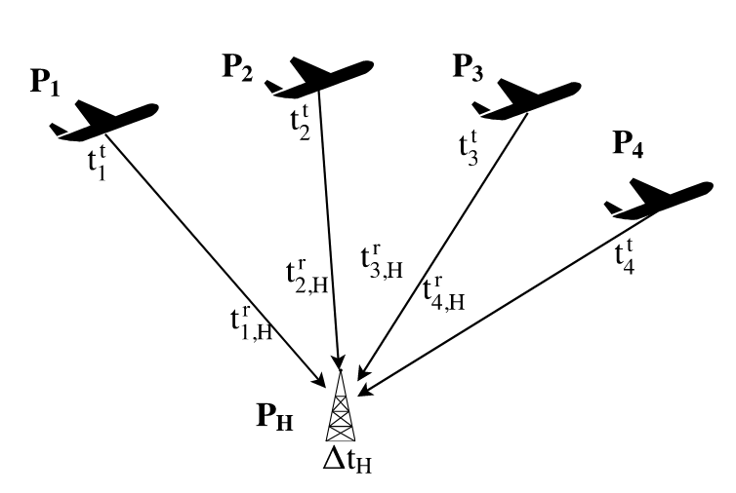
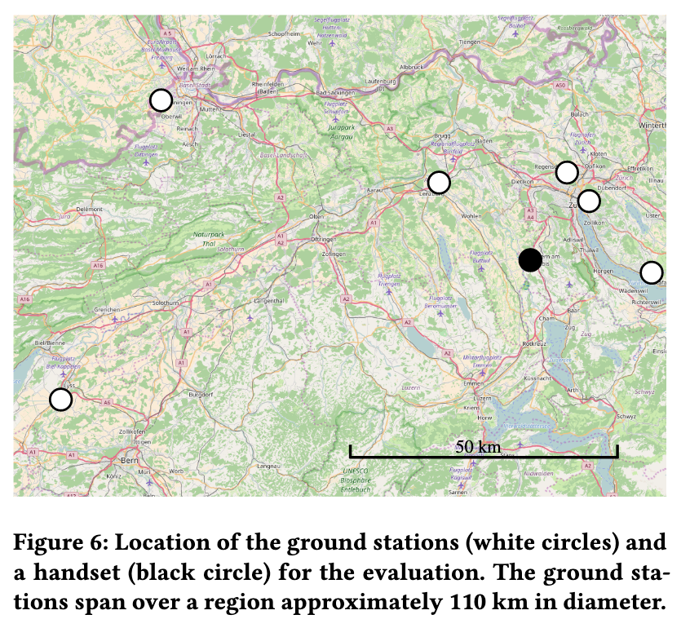
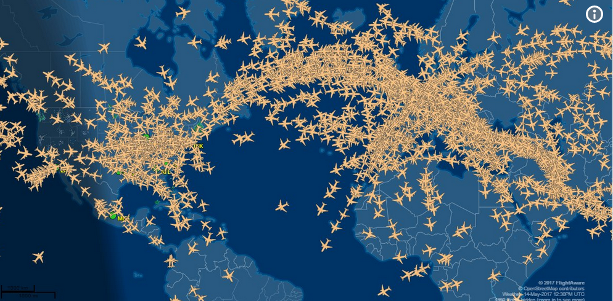
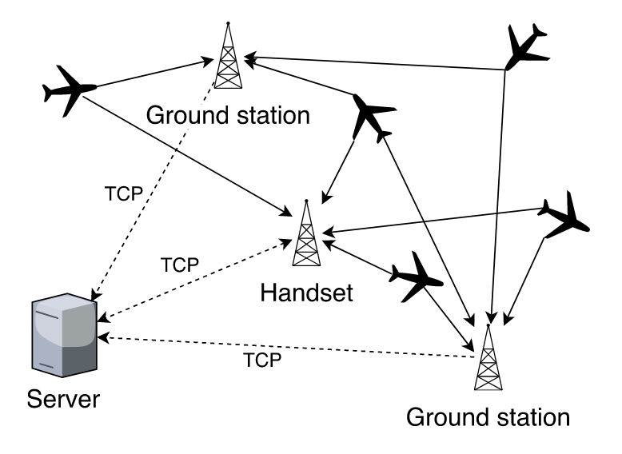
Sometimes things in the physical world only happen just that way, just that once
Idea: ADS-B signals from planes are plentiful and strong – indoor GPS??
Last year, from 3,354 to 12,856 planes in the sky
Manuel Eichelberger, Kevin Luchstinger, Simon Tanner, Roger Wattenhofer, Indoor Localization with Aircraft Signals, SenSys 2017
Notes:
When & where
https://www.travelandleisure.com/airlines-airports/number-of-planes-in-air

Slide 11
Example: RF-IDraw
Jue Wang, Deepak Vasisht, and Dina Katabi, RF-IDraw: Virtual Touch Screen in the Air Using RF Signals, SIGCOMM’14

Slide 12
Example: Tagoram / RFID trackers

Slide 13
Example: Wi-Fi / etc fingerprinting

Slide 14
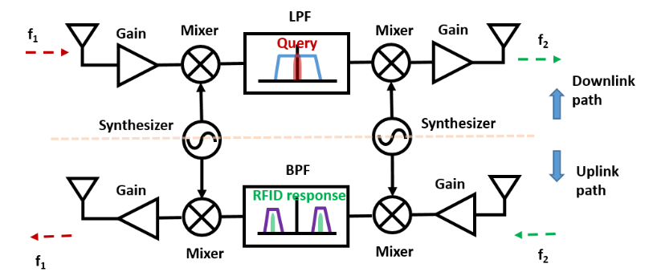
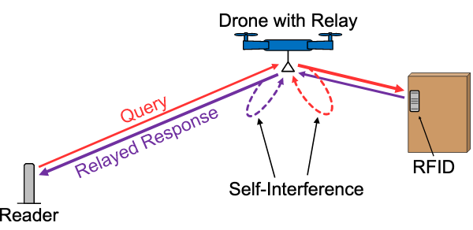
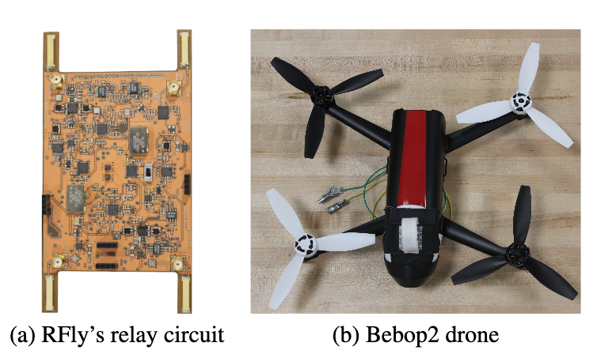
Sometimes interesting ideas require interesting hardware
Idea: Resolve RFID range/coverage with relay on a drone
Yunfei Ma, Nicholas Selby, Fadel Adib, Drone Relays for Battery-Free Networks, SIGCOMM’17

Slide 15
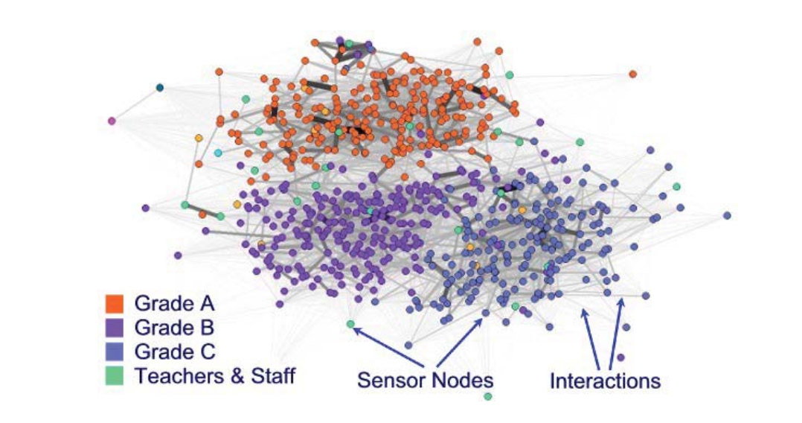
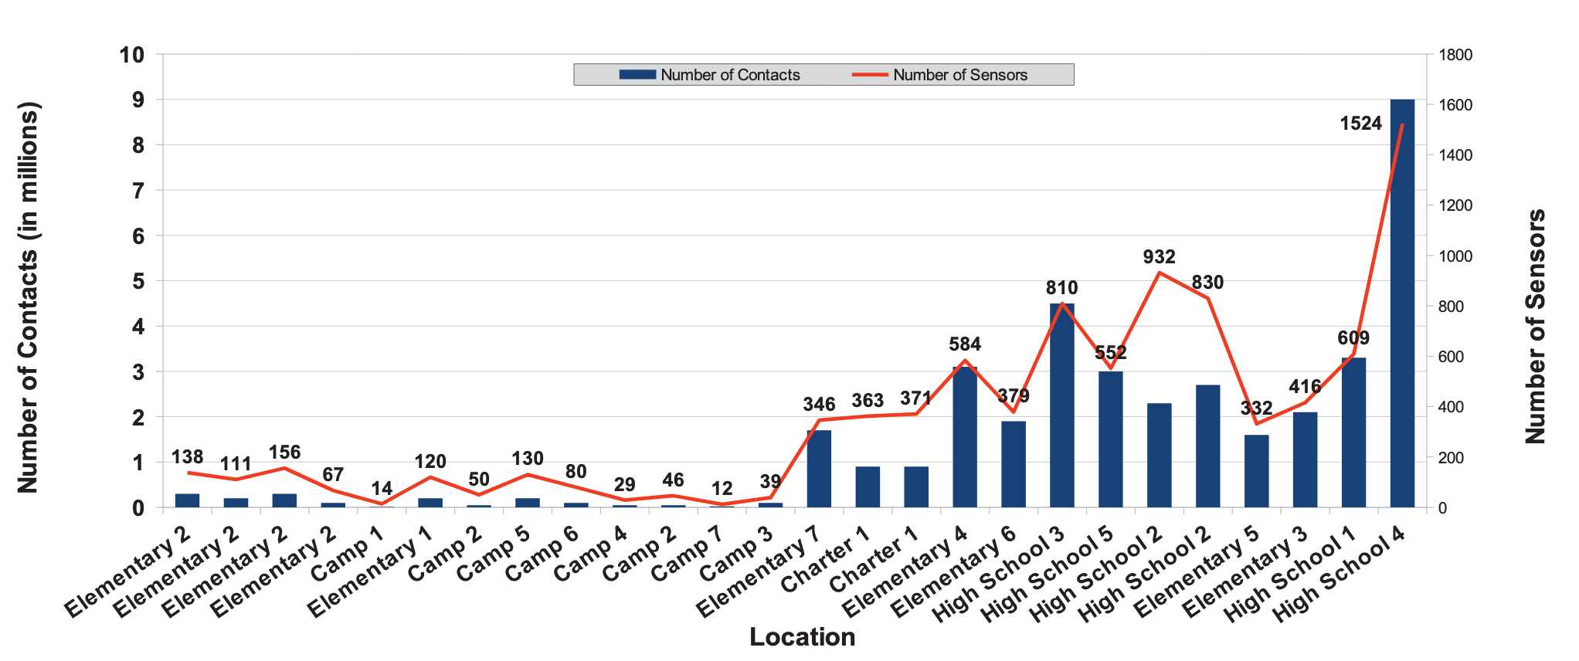
Sometimes interesting work comes from data that is not easily shared
Finding people is interesting, protecting their privacy is hard
Kyeong T. Min, Andrzej Forys, Anh Luong, Enoch Lee, Jon Davies, Thomas Schmid, WRENSys: Large-Scale, Rapid Deployable Mobile Sensing System

Slide 16
Should a discussion of reproducibility be required?
“Future Work” – how and by whom?
Are irreproducible results intrinsically bad?
Internally reproducing experiments…
Run trials until you get the good looking graph, discard the rest
Can we create a reviewer checklist?

Slide 17
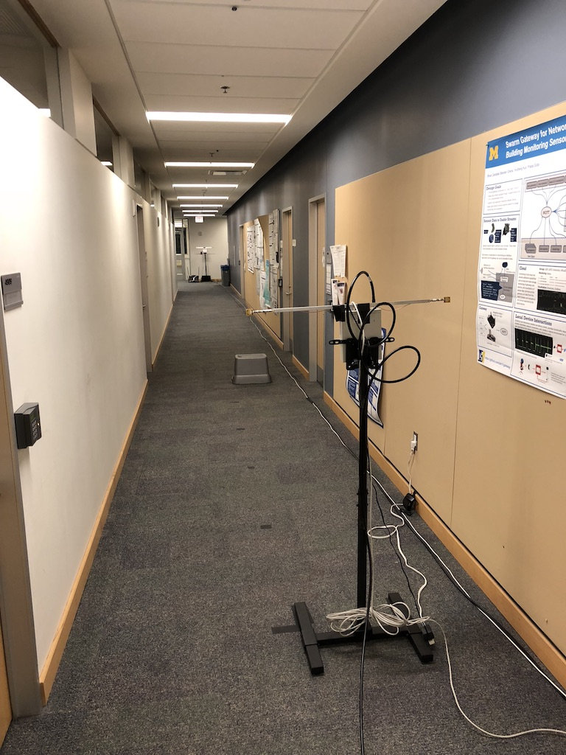
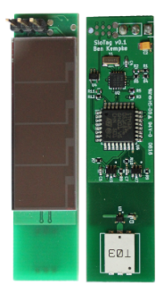
Are datasets the answer?
Shameless plug: DATA workshop at SenSys again this year
Expanded scope: ”The collection and use of data”, what makes datasets useful?
Dataset release enables post-hoc benchmarking
Slocalization
Have ~36 GB of data traces still around
Maybe half of which ended up in the paper…
And there are graphs where the data is gone
Interesting problems in the data, but unlabeled
Non-deterministic reward!

Slide 18
Outline
Reproducibility
Planes: Scenarios that cannot be (easily) replicated
Trains: How to design ground truth
Comparisons
Apples & Oranges: How to quantitatively compare different architectures?
Notes:
Infra/Infra-free; Symmetric / Asymmetric; Application-oriented

Slide 19
Ground truth is the localization chicken and egg problem
If you build a better localization system than anything that has come before, how do you evaluate it?
Notes:
Metrology question

Slide 20

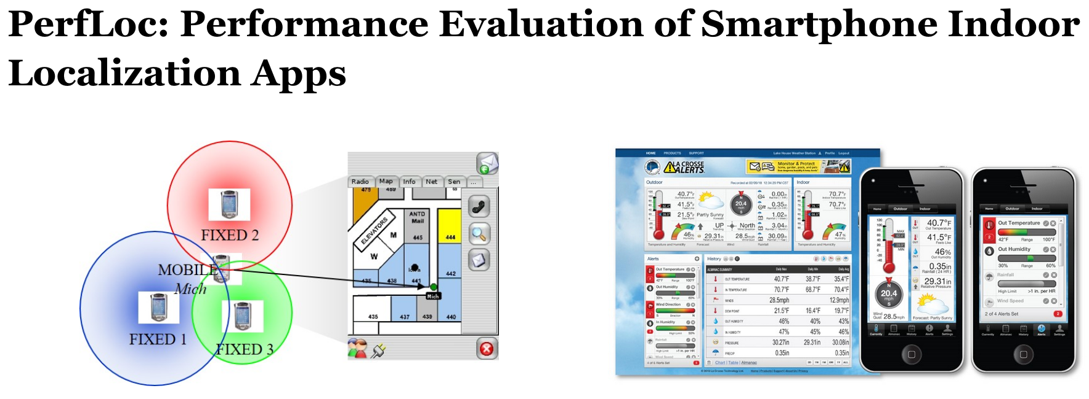
For a metrology problem, let’s look to the metrology experts!
New standard dataset for “infrastructure-free” systems

Slide 21
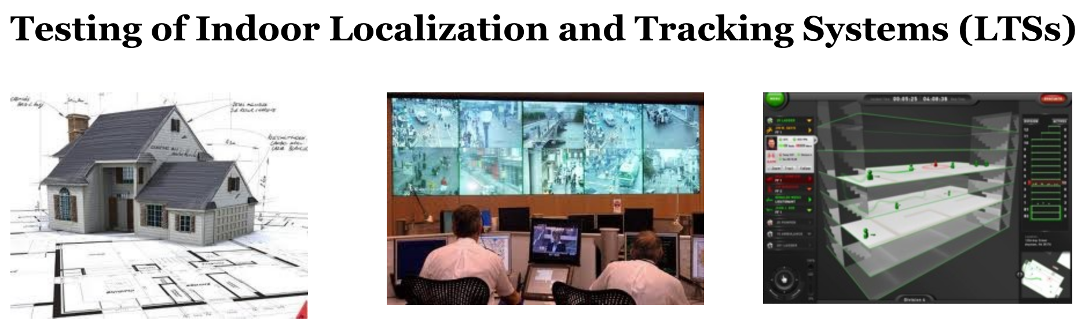
For a metrology problem, let’s look to the metrology experts!
ISO/IEC 18306: 2016
identifies appropriate performance metrics and test & evaluation scenarios for localization and tracking systems, and it provides guidance on how best to present and visualize the T&E results.

Slide 22
Standardized test environments lag the leading edge of research ideas
There is a gap between new technique and 1,300+ point measurement
Good for capstone research, product development

Slide 23
Is a FlockLab of localization plausible?
Something lighter weight than NIST testbed
Do novel physical layer enhancements make this impossible?
Hardware to testbed versus testbed to hardware?
Or do SDRs save the day?

Slide 24
What are we doing today?
In the absence of a standard testbed…

Slide 25
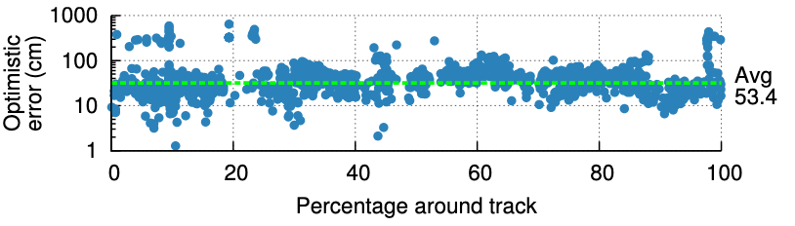
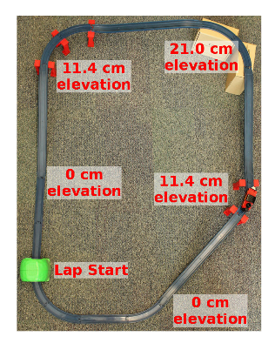
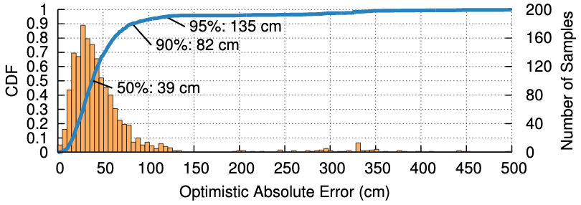
Capturing accurate ground truth can be challenging
As the exact position of the tag in space and time is unknown when each sample is taken, we compute the optimistic error, that is the minimum distance from a Harmonia location estimate to the nearest point on the track.
Benjamin Kempke, Pat Pannuto, and Prabal Dutta, Harmonia: Wideband Spreading for Accurate Indoor RF Localization, HotWireless’14

Slide 26
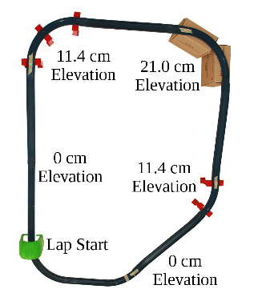
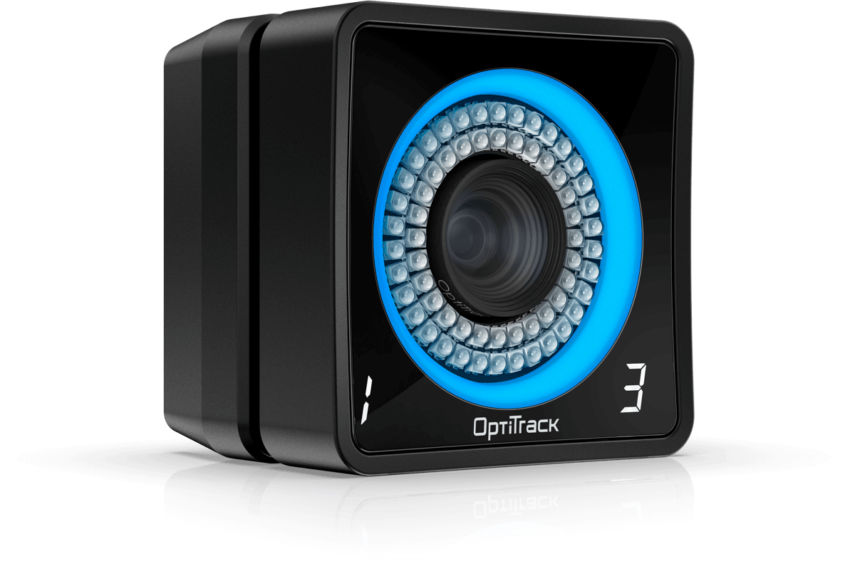
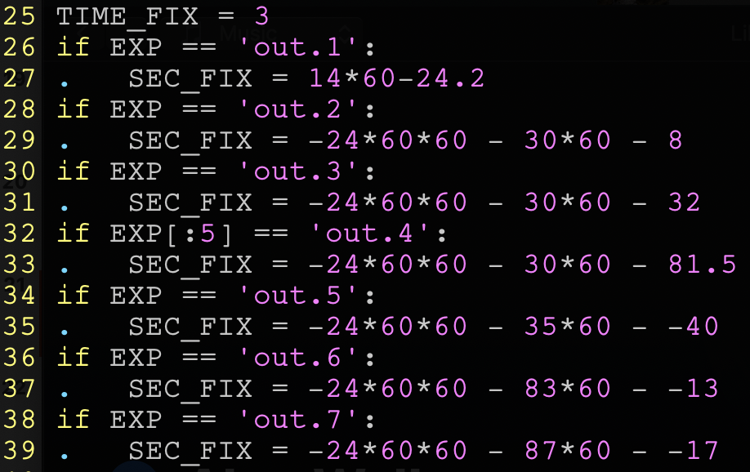
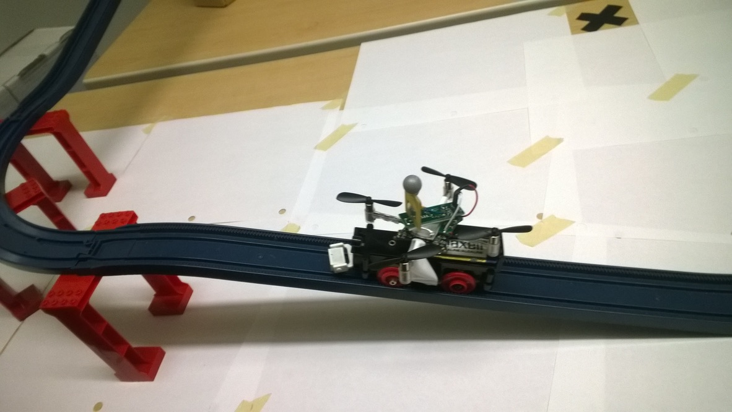
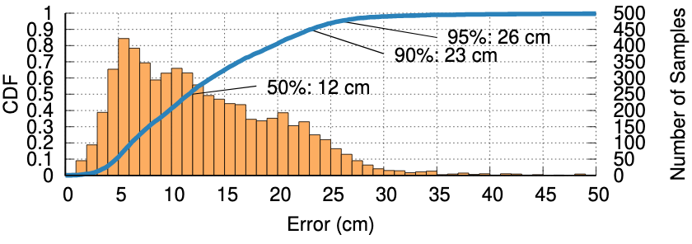
We have solutions, but they can be prohibitively expensive
Benjamin Kempke, Pat Pannuto, and Prabal Dutta, Harmonium: Asymmetric, Bandstitched UWB for Fast, Accurate, and Robust Indoor Localization, IPSN’16

Slide 27
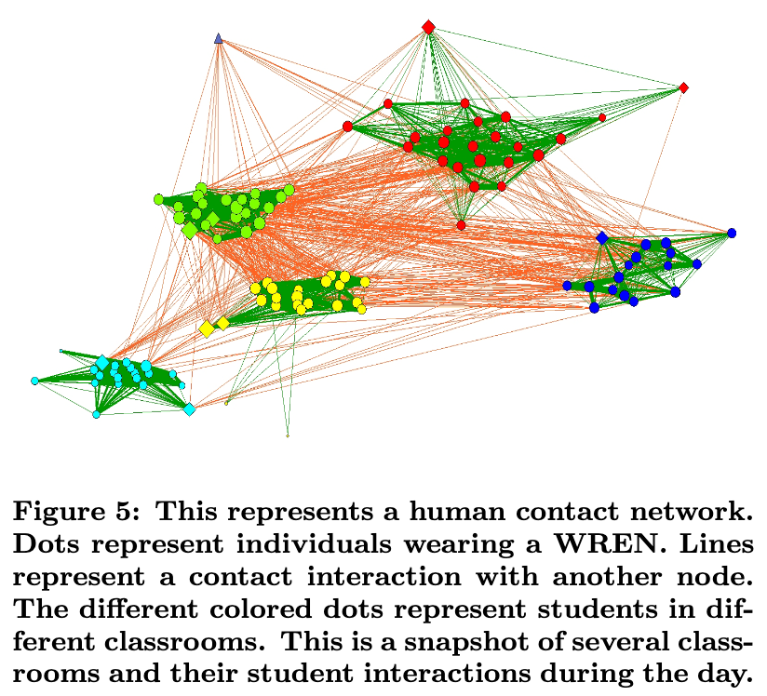
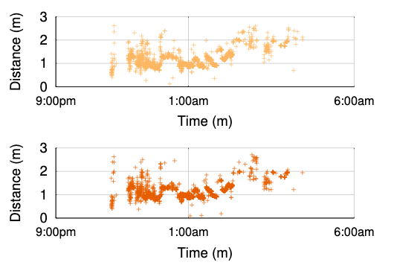
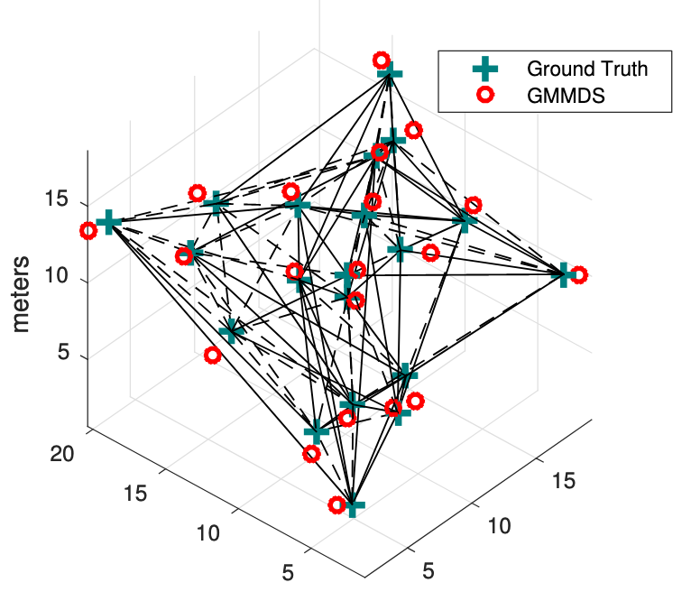
We have no idea how to handle evaluations in infrastructure-free scenarios
What do you do when you cannot instrument evaluation spaces?
State-of-the-art: Internal consistency and satisfying intuitions

Slide 28
Experimental design is being under-reported
One of the original motivations for the Indoor Localization Competition
Reviewers of localization papers should critically analyze ground truth
”We used an expensive good system” is not enough!

Slide 29
Outline
Reproducibility
Planes: Scenarios that cannot be (easily) replicated
Trains: How to design ground truth
Comparisons
Apples & Oranges: How to quantitatively compare different architectures?
Notes:
Reproducibility versus the real world
Infra/Infra-free; Symmetric / Asymmetric; Application-oriented

Slide 30
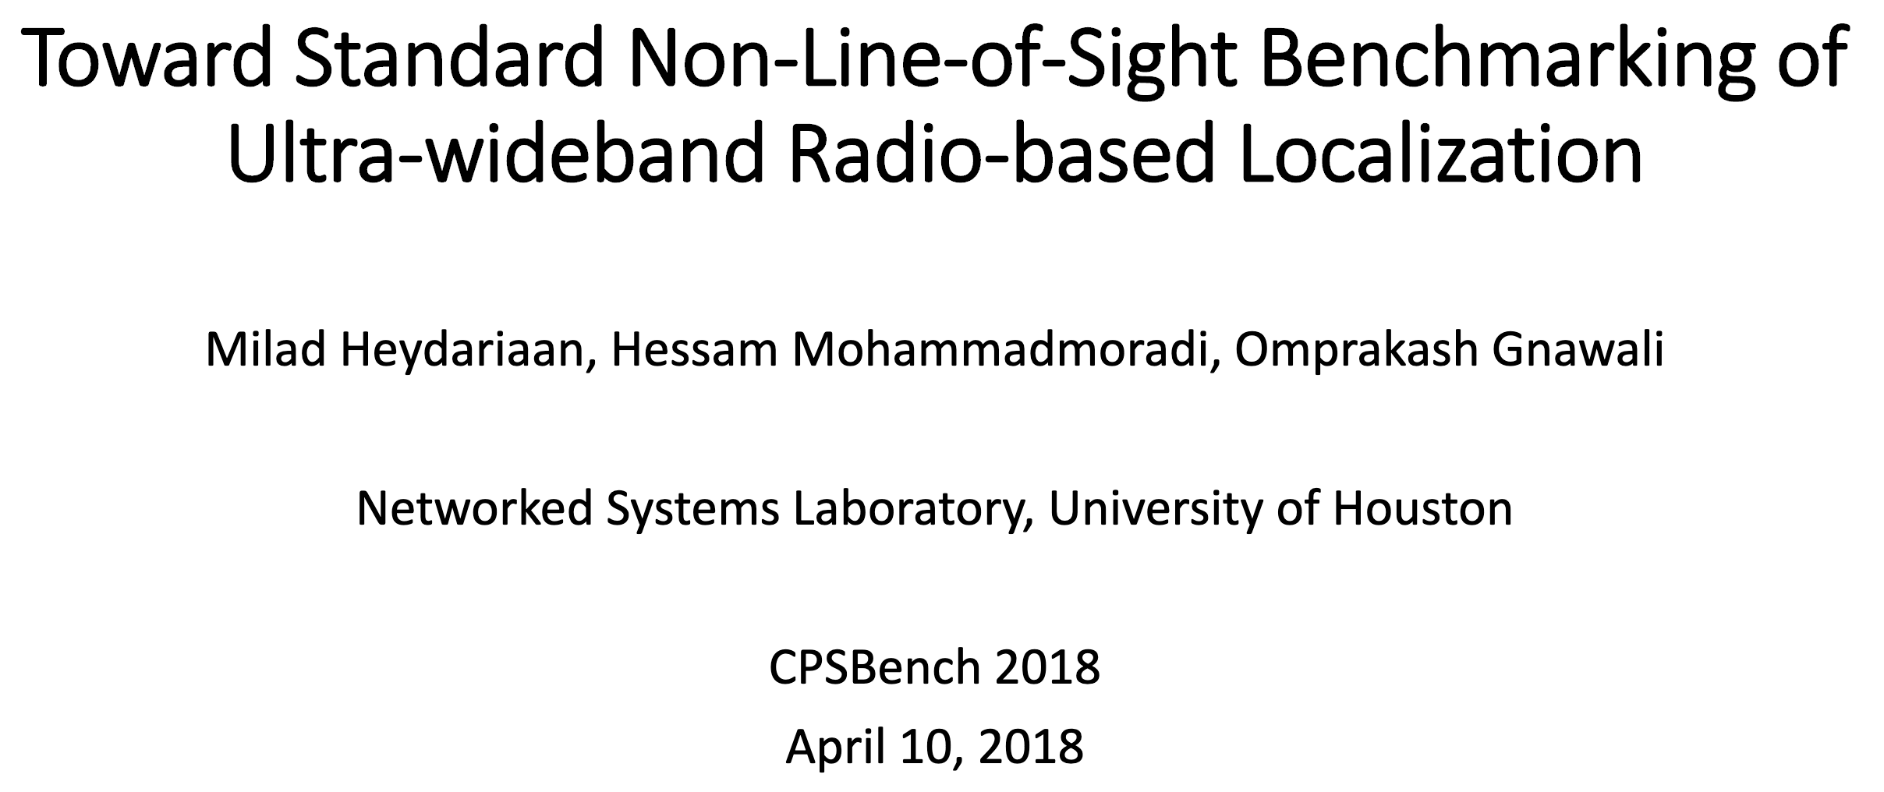
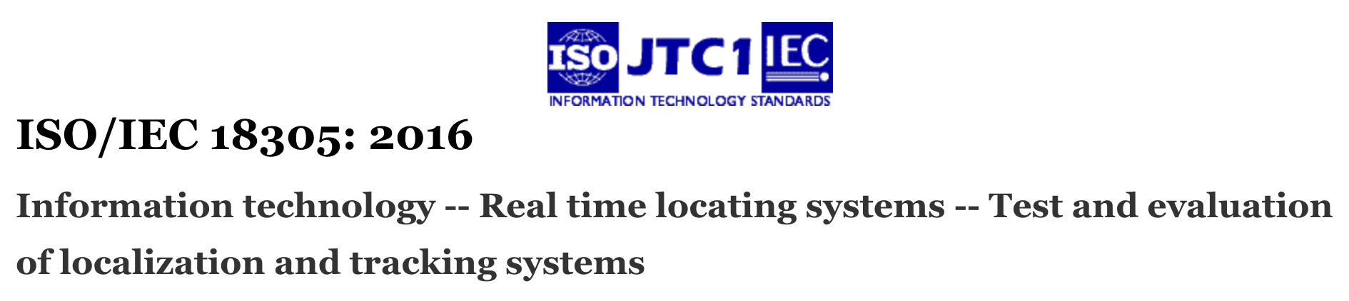
Step 1: We all need to agree on the underlying language
Bottom-up and top-down efforts here

Slide 31

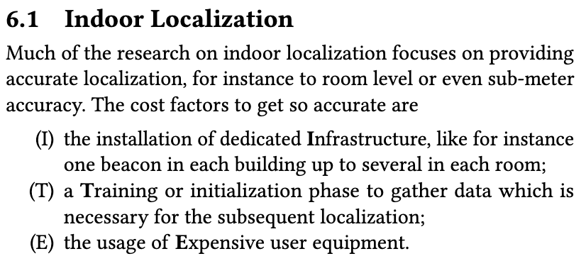
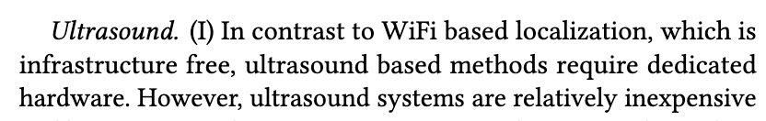
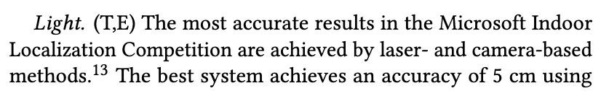
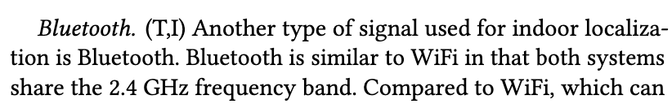
Related work sections are the art of choosing a different subset of metrics
No longer just the binary ’this metric is important’
Mautz, Rainer. "Indoor positioning technologies." (2012).

Slide 32
Abstracts demand “one-number” performance
People “need” a quick handle for comparison
Needs to be novel mechanism, and it needs to be better result
And it’s in your interest for this number to be better than previous numbers
Median, 90th, 99th, worst-case?
Application dependent?
Then how do we compare??

Slide 33
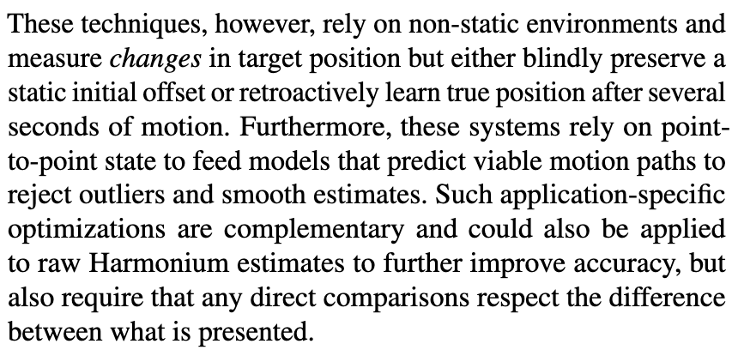
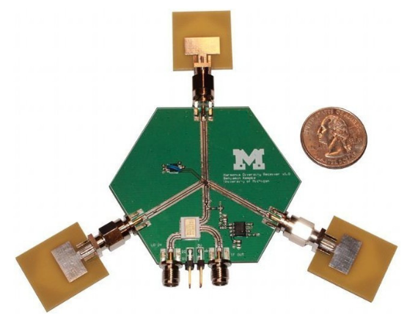
Newer innovations becoming increasingly cross-layer
Systems papers as a disservice?
Improve physical layer measurement AND processing layer technique
(Particle/Kalman filtering etc)
And what’s the physical layer anyway?

Slide 34
Datasets are an opportunity to decouple?
But not everything is always collected
Slocalization
Direct physical channel ~1536 MB/sec baseband [decimated on FPGA]
“Raw” IQ data logged ~100 GB
Processed to recover CIRs ~100 MB
Processed to recover locations ~100 kB
Bigger data is often harder to use, generalize, and share

Slide 35
Growing the scope of CPSBench? Venue for (ir)reproducible results?
Great intro-to-a-new-area type of work
Community should value and provide a venue to publish reproduction efforts
Particularly interesting to “reproduce” in new physical spaces
Or otherwise challenge understated assumptions
Many other communities have or are growing similar things
ISCA + Workshop on Deduplicating, Deconstructing, and Debunking (14 years!)
ICLR + Workshop on Reproducibility in Machine Learning (3 years)
IEEE RAM + Short replication articles (r-articles) (2 years)

Slide 36

Conclusion / Looking toward the next session… What role does CPS-IoTBench have moving forward?
Venue has the potential to be authority for CPS evaluations
Need to allow new ideas to have imperfect evaluations! (Within reason….)
Research != product, “Prove it’s possible”
Let science take its course and develop corrections
Service to the community
Validation of prior work
Resolution of evaluation metrics for new physical-world ideas
patpannuto.com @patpannuto

